Slide 1
Network Interface Card
Chapter 4

Slide 2
Learning Objectives
Describe role a network adapter card plays in networked communications
Explain how network adapters prepare data for transmission, accept incoming network traffic, and control how networked communications flow
Understand variety of configurable options for network adapters, and describe common settings

Slide 3
Learning Objectives
Describe important characteristics for selecting adapter cards
Recount network adapter enhancements that can improve performance
Explain role of driver software in network adapters

Slide 4
Network Interface Card (NIC) Basics
Plugs into expansion slot
Provides physical interface between computer and network medium
Performs two crucial tasks
Establishes and manages computer’s network connection
Translates data into signals for outgoing messages and translates signals for incoming messages

Slide 5
From Parallel to Serial, and Vice Versa
Most computers use parallel data lines, called bus, to send data between CPU and adapter cards
Most networking media transmits data in single line, called serial transmission
NIC translates parallel into serial for outgoing messages and serial into parallel for incoming messages
See Figure 4-1

Slide 6
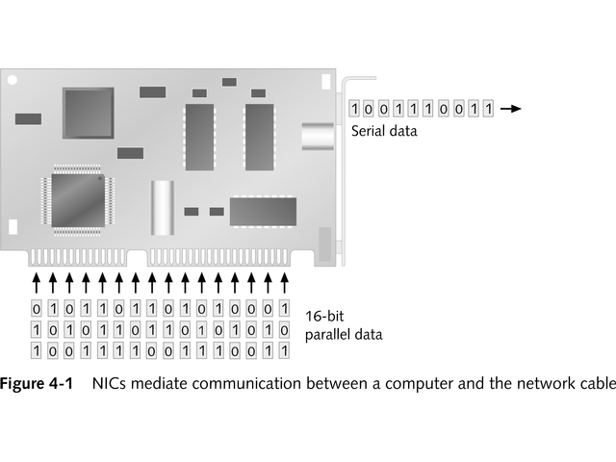
NIC Allows the Computer and the Network Cable to Communicate

Slide 7
Understanding the Bus
Bus width refers to number of parallel lines, each able to move one bit at a time
Industry Standard Architecture (ISA) has an 8- or 16-bit bus
Later 32-bit and 64-bit buses were introduced
The 64-bit Peripheral Component Interconnect (PCI) is fastest and most popular bus today

Slide 8
Transceiver
Designed for specific medium
NIC accesses transceiver to transmit data
Some NICs include transceiver
Ethernet can use variety of media
Some Ethernet NICs offer multiple interfaces
See Figure 4-2
Newer NICs have only one type of media connector

Slide 9
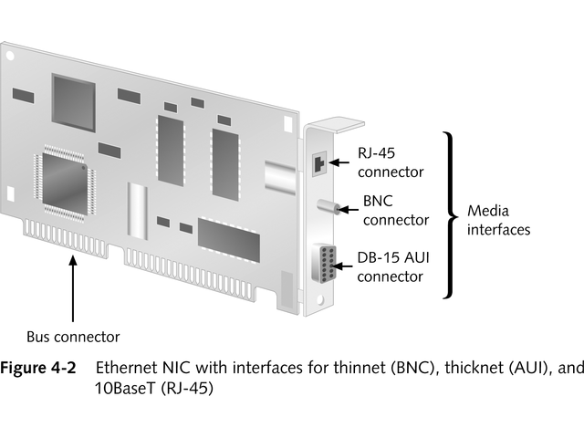
Ethernet NIC

Slide 10
NICs and Packets
Packets are basic unit of data for network transmission and reception
NICs create packets of bits
Transmit packets serially onto network medium
Act as gatekeeper, allowing only inbound packets intended for its computer

Slide 11
MAC Address
NIC has unique identifier, called Media Access Control (MAC) address
Programmed into ROM chip
48-bit number, written as six two-digit hexadecimal numbers separated by colons
First part identifies manufacturer
Second part unique to each NIC

Slide 12
PC Buses
Industry Standard Architecture (ISA) uses 8- or 16- bit bus with top speed of 10 MHz
Extended Industry Standard Architecture (EISA) offers 32-bit bus
Micro Channel Architecture (MCA) is IBM’s proprietary 32-bit bus with speed up to 66 MHz

Slide 13
PC Buses
Peripheral Component Interface (PCI) is newest 64-bit version of high-speed local bus
PC card is credit-card size expansion card; includes NICs, even wireless NICs
Accelerated Graphics Port (AGP) is high speed graphics port

Slide 14
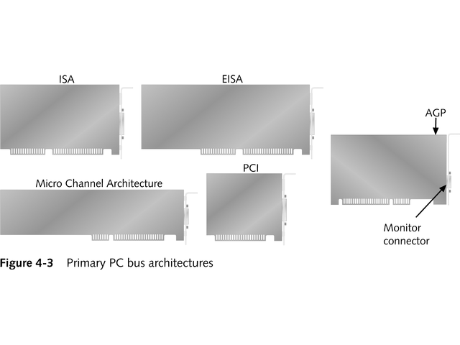
Primary PC Bus Architectures

Slide 15
Other PC Interfaces Used for Networking
Universal Serial Bus (USB) is serial interface for low-speed peripheral devices
FireWire (IEEE 1394) is high-speed serial bus with bandwidth up to 400 Mbps used for digital cameras and video devices
New version, 1394b, supports transfers up to 3200 Mbps

Slide 16
Principles of NIC Configuration
Match NIC to slot on PC or external connection such as USB
Plug and Play usually configures NIC recognized by power-on self-test (POST)
If necessary, manually configure NIC
NIC configuration involves three settings:
Interrupt Request line (IRQ)
Base I/O port
Base memory address

Slide 17
Making the Network Attachment
NIC performs several roles:
Establishes physical link to networking medium
Generates signals that traverse networking medium
Receives incoming signals
Implements controls that determine when signals transmit to or are received from network medium
Connections on NIC determine media type
May need to set jumpers or DIP switches to select media used

Slide 18
Choosing Network Adapters for Best Performance
NICs affect network performance
Consider several enhancements that can affect speed and data-handling capabilities:
Direct Memory Access (DMA)
Shared adapter memory
Shared system memory
Bus mastering
RAM buffering
On-board co-processors
Security features
Traffic management
Fault tolerance
Improved management features

Slide 19
Special-Purpose NICs
Several type of NICs deliver specialized capabilities
Wireless Adapters
Remote Boot Adapters

Slide 20
Wireless Adapters
Include some or all of these components:
Indoor antenna and antenna cable
Software to enable adapter to work with particular network environment
Diagnostic software to check installation or troubleshoot
Installation software
Remote Boot Adapters
Used with wireless access point to add wireless devices to existing wired network

Slide 21
Remote Boot Adapters
Diskless workstations boot up by reading information from disk
NIC has Boot PROM (programmable read-only memory) that is PXE compliant
Includes hardwired code to start computer and access the network
Advantages of remote boot adapters include cost saving, better reliability, and increased security

Slide 22
Driver Software
NIC requires software device driver
Small specialized program that manages communications between operating system and NIC
Poorly written or incorrect drivers may prevent PC from booting or may have detrimental impact on network performance
Earlier, each NIC vendor built its own driver
Now, operating system vendors define drivers

Slide 23
Driver Software
Three major vendor standards for drivers:
Network Device Interface Specification (NDIS) defines interface between MAC sublayer and NIC driver; lets NIC to use multiple protocols
Win32 Driver Model (WDM) defines interface for PCs with modern Windows operating systems; improves driver quality by dividing drivers by function
Open Data-link Interface (ODI) defined by Apple and Novell allows NIC to use multiple protocols

Slide 24
Driver Software
Installing NIC driver is usually easy
Many operating systems include drivers for most popular NICs or NICs may come with drivers
Most installation programs provide GUI to help with installation
Figure 4-4 shows how to install network connection on Windows 2000, including software driver
User supplies configuration information, such as IRQ and base I/O port

Slide 25
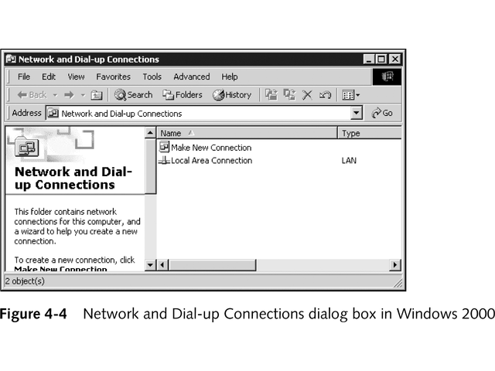
Network and Dial-up Connections Dialog Box

Slide 26
Driver Software
NIC drivers continue to evolve
Check manual for NIC
Check vendor’s Web site and technical support line
Many manufacturers supply knowledgebase with problems and resolutions
Update drivers when newer one is available

Slide 27
Chapter Summary
Network interface cards (NICS) provide interface between computer and networking medium
NICs prepare, send, and control data flow across network
To send data, NIC must reformat outgoing data from parallel to serial and reverse the process to receive data
Each NIC has unique hardware network address

Slide 28
Chapter Summary
NICs have configurable options that must be set for the adapter to make a network connection
Some NICs may require unique interrupt request line (IRQ), base I/O port, and base memory address
These options may be selected by Plug and Play
Edge connector of NIC must match PC slot into which it will plug
NICs media attachment must match network medium and connector type to which it will connect

Slide 29
Chapter Summary
NICs have profound effect on overall network performance
Options, such as Direct Memory Access (DMA), shared adapter or system memory, and bus mastering, enhance capabilities of NIC
Using RAM buffering or incorporating on-board co-processor can improve performance
Some NICs include specialized capabilities, such as hot plug, dual ports, security settings, management interfaces, wireless communications, and remote boot support

Slide 30
Chapter Summary
Consider this checklist when selecting a NIC
Bus width: wider is better, use PCI or PCI-X
Bus type: use PCI-X for servers when possible
Memory transfer: shared memory outpaces I/O or DMA
Special features required: security, management, protocol handling, hug-plug capable
Bus mastering: important for servers
Vendor factors: quality, reliability, staying power, reputation

Slide 31
Chapter Summary
Driver software is crucial for NIC to communicate with computer’s operating system
Make sure valid driver is available for your operating system
Always use latest driver version
Make regular driver upgrades part of network maintenance routine

